Slide 1
ARISTOTLE UNIVERSITY OF THESSALONIKI
FACULTY OF SCIENCES
SCHOOL OF INFORMATICS
POSTGRADUATE STUDIES PROGRAM ON INFORMATICS AND COMMUNICATIONS
SPECIALIZATION ON DIGITAL MEDIA AND COMPUTATIONAL INTELLIGENCE
Content-based Image Retrieval
Presenter: Efstathios Chatzikyriakidis
M.Sc. in Informatics and Communications
Specialization in Computational Intelligence and Digital Media
School of Informatics, Faculty of Sciences
Aristotle University of Thessaloniki, Hellas
B.Sc. in Informatics and Communications
Specialization in Software Engineering
Department of Informatics and Communications, Faculty of Applied Technology
Technological Educational Institute of Central Macedonia, Hellas
Email : contact@efxa.org Website : http://www.efxa.org/

Slide 2
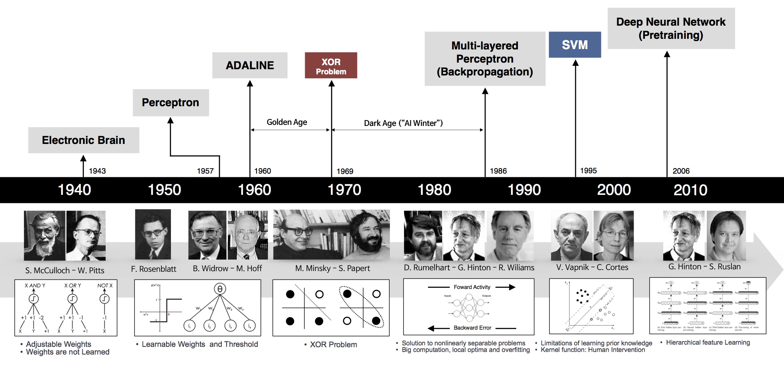
Introduction
Important history of “Artificial Intelligence”
We had a long journey… and we are still at the birth of it...

Slide 3
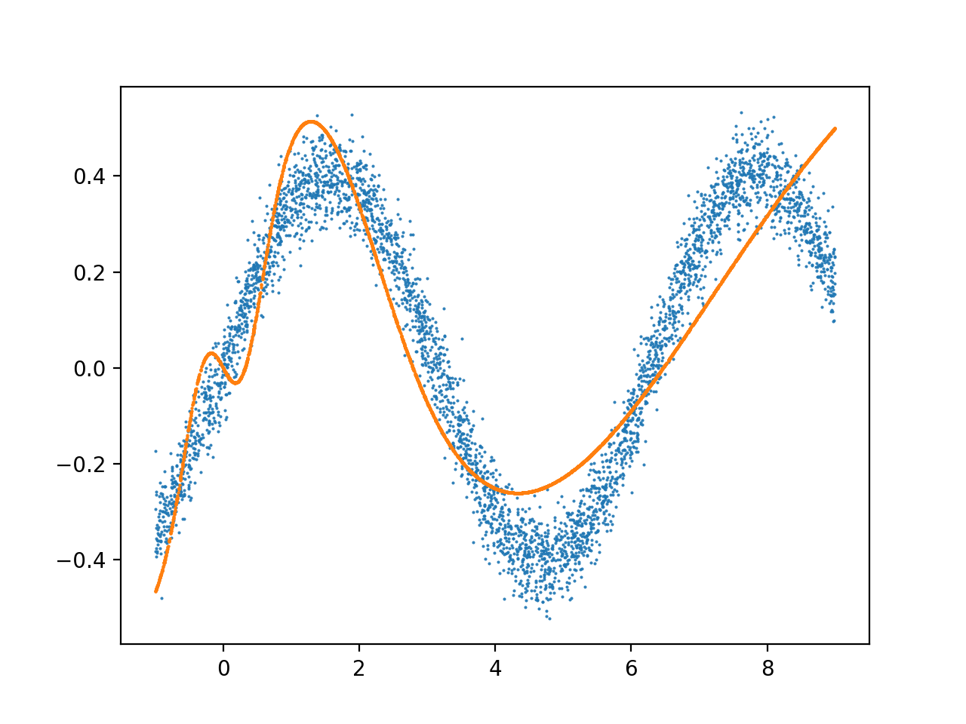
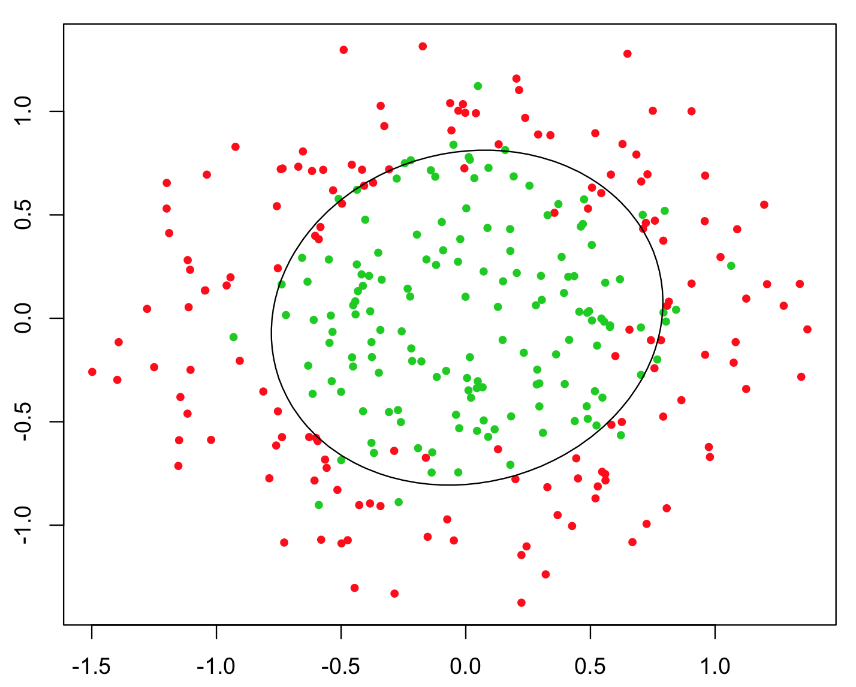
Introduction
Αdvantages of Artificial Neural Networks
Satisfactory separation of non-linear separable input data
Satisfactory function approximation using only input data

Slide 4
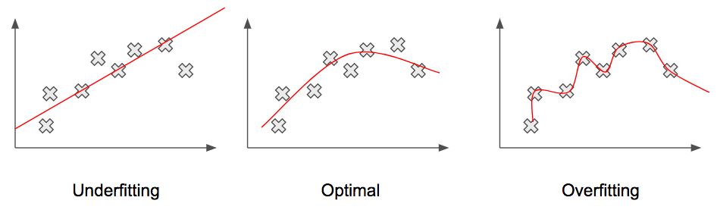
Introduction
Αdvantages of Artificial Neural Networks
Good generalization that captures the general manifold of data

Slide 5
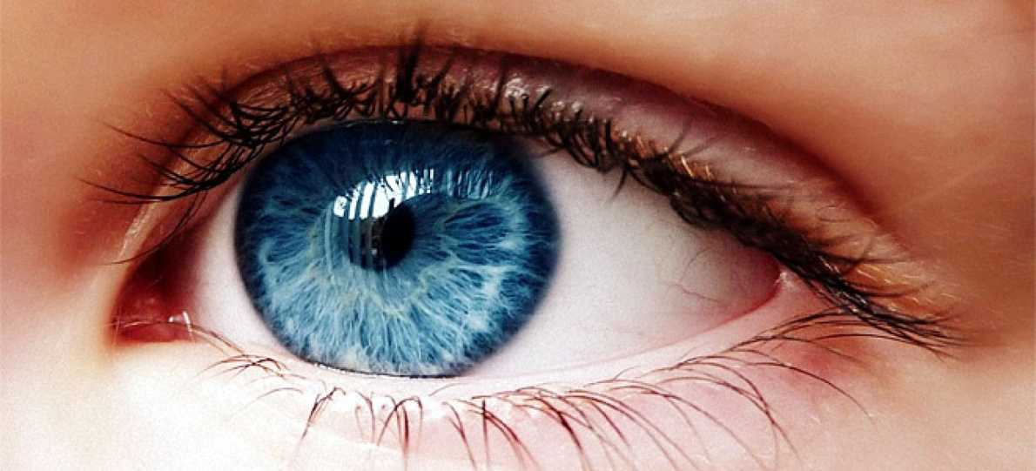
Introduction
Computer Vision and its future goal
The strongest sense of most animal species
Simulate how brains see and understand the world through vision sense

Slide 6

Computer Vision
Well-known tasks of high-level image understanding

Slide 7
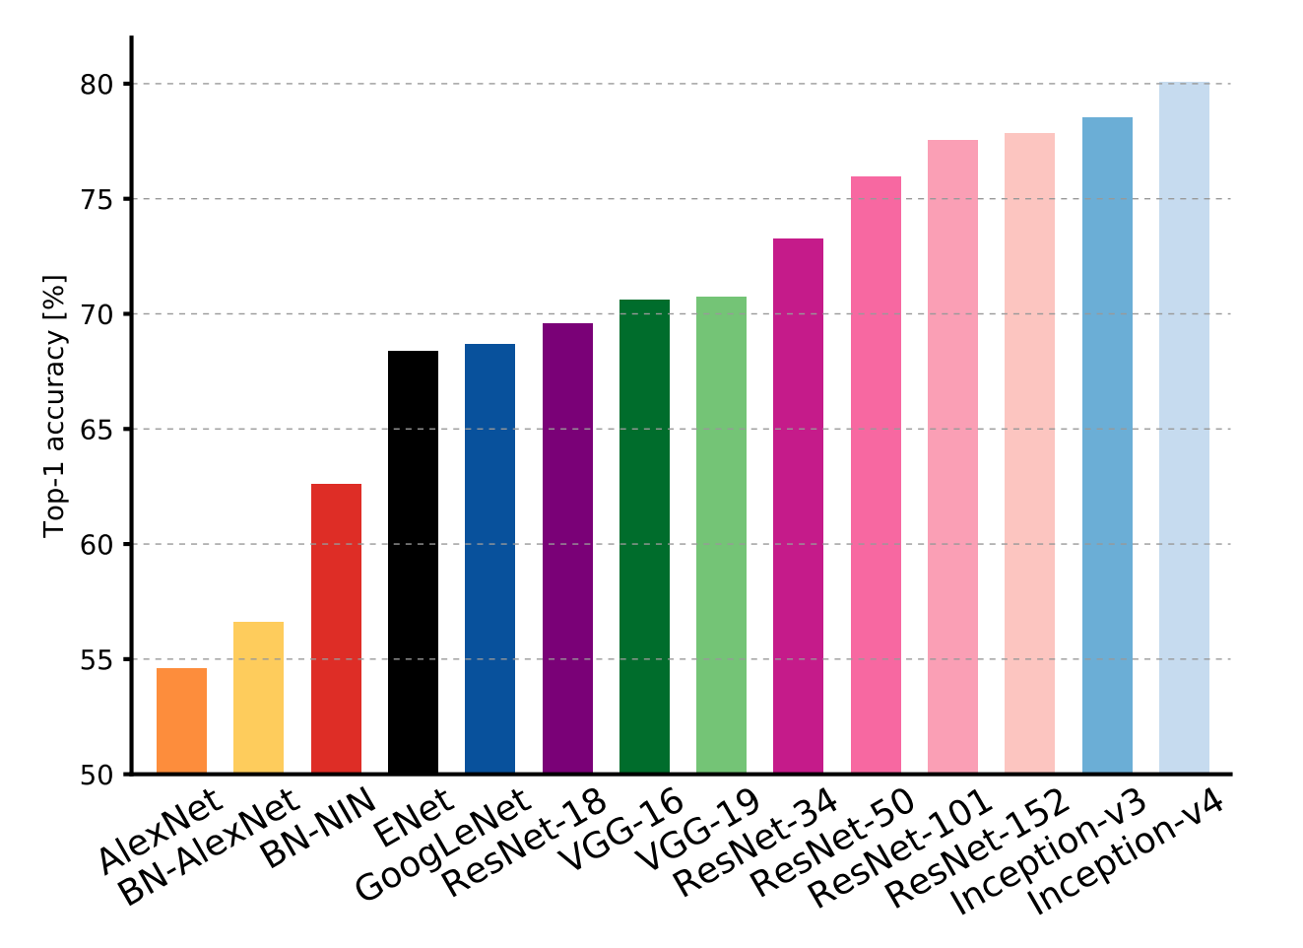
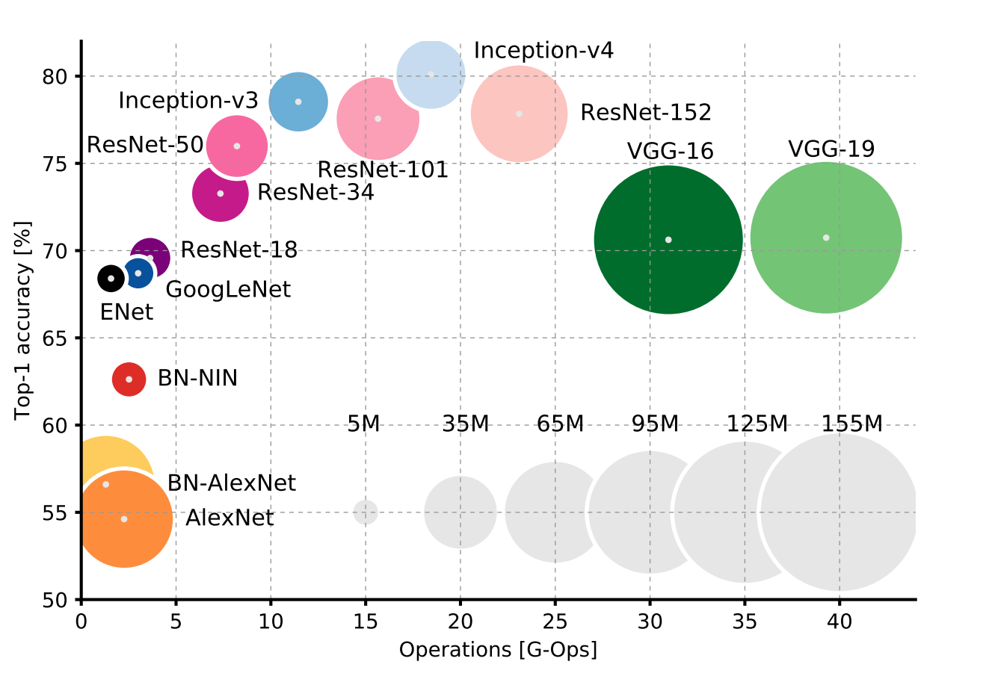
Computer Vision
State-of-the-art Image Classification
ImageNet Large Scale Visual Recognition Challenge (ILSVRC)

Slide 8
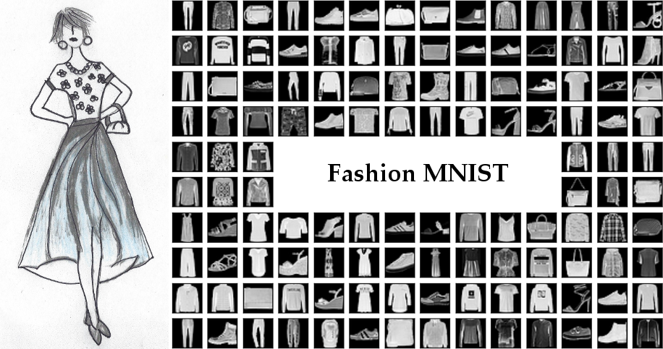
Dataset
Fashion MNIST

Slide 9
Dataset
Fashion MNIST
Characteristics:
total of 70000 grayscale images
28x28 pixels (image resolution)
10 class labels
60000 training images (6000 images per class label)
10000 testing images (1000 images per class label)

Slide 10
Dataset
Fashion MNIST
Class labels:
T-shirt/top
Trouser
Pullover
Dress
Coat
Sandal
Shirt
Sneaker
Bag
Ankle boot

Slide 11
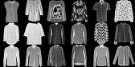
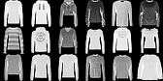
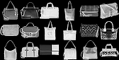
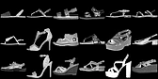
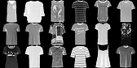
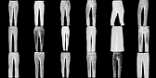
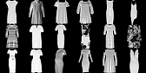
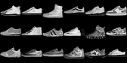
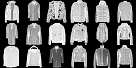
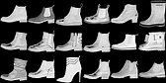
Dataset
Fashion MNIST

Slide 12
Content-based Image Retrieval
Using KNN, convolutional feature extractors and similarity metrics
Steps:
Train a convolutional neural network for multi-label classification
Use the trained convolutional feature extractors to extract the image feature vectors
Fit a KNN model with the extracted image feature vectors
For an input query image:
Extract its image feature vector using the same feature extractors
Use the KNN model and find the closest K neighbors using a similarity metrics
Run various experiments and report precision and recall curves

Slide 13
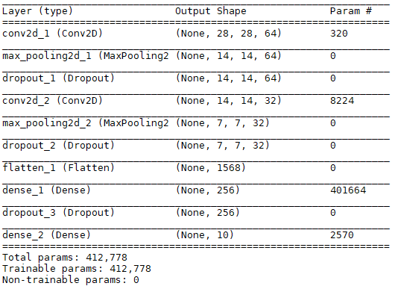
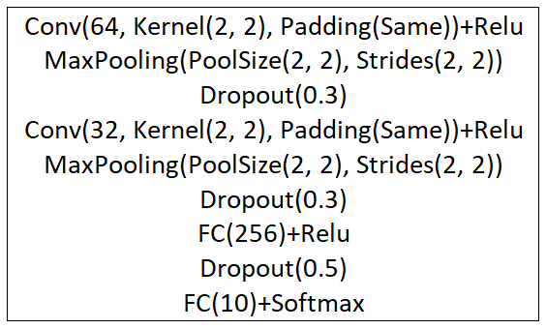
Convolutional Neural Network Topology
Summary and architecture of the neural network

Slide 14
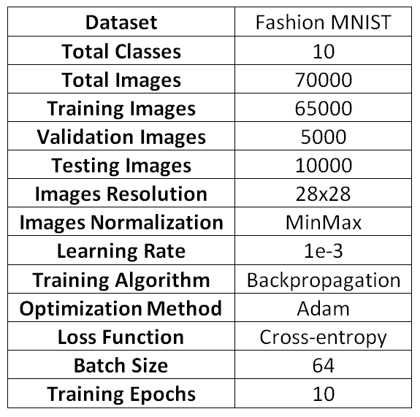
Convolutional Neural Network Topology
Training information

Slide 15
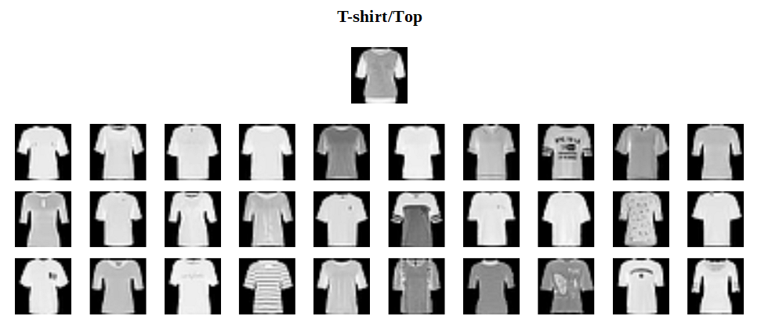
Example Queries
Example 1 (closest K=30 neighbors)

Slide 16
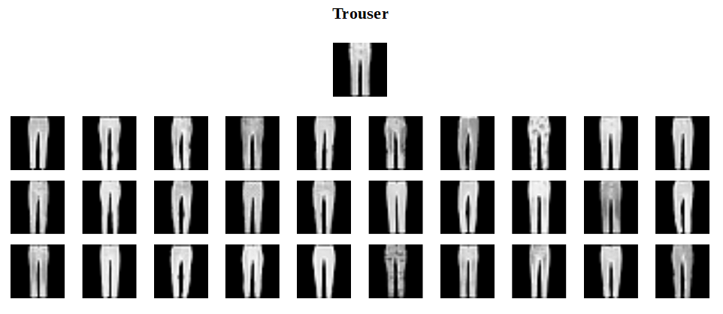
Example Queries
Example 2 (closest K=30 neighbors)

Slide 17
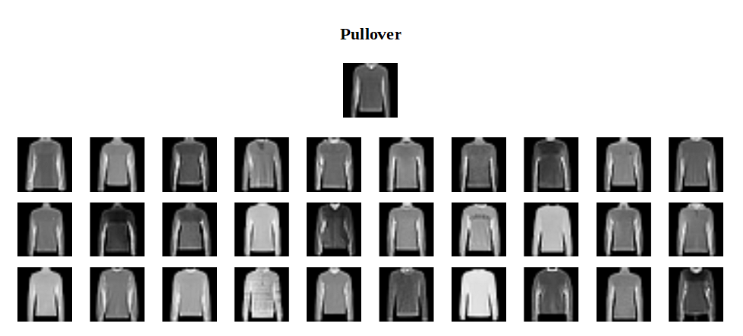
Example Queries
Example 3 (closest K=30 neighbors)

Slide 18
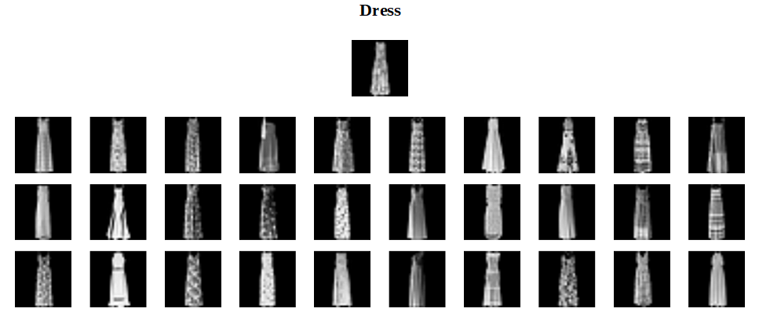
Example Queries
Example 4 (closest K=30 neighbors)

Slide 19
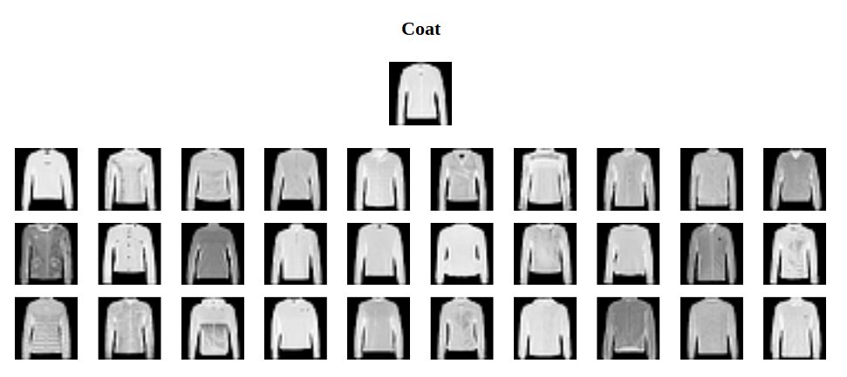
Example Queries
Example 5 (closest K=30 neighbors)

Slide 20
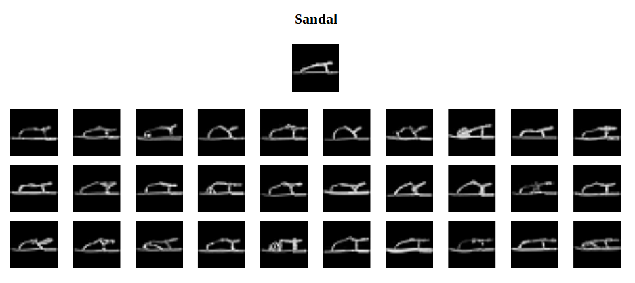
Example Queries
Example 6 (closest K=30 neighbors)

Slide 21
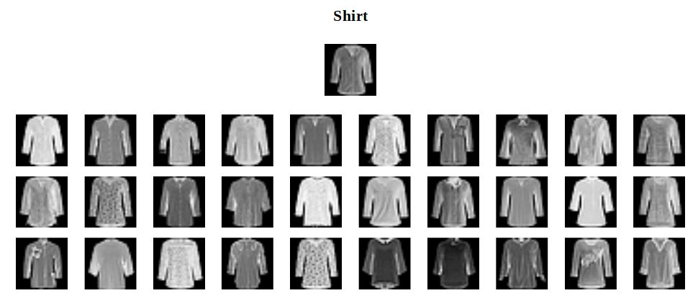
Example Queries
Example 7 (closest K=30 neighbors)

Slide 22
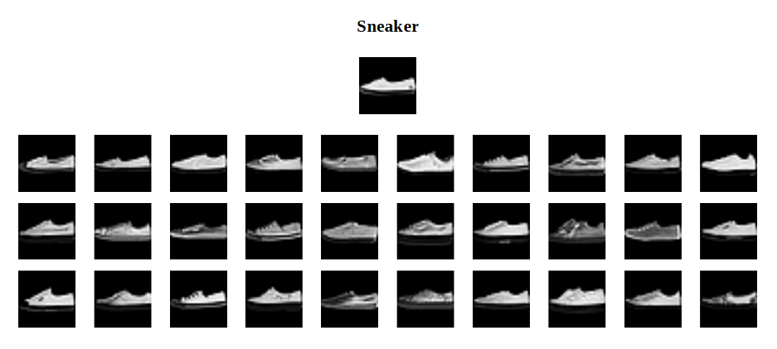
Example Queries
Example 8 (closest K=30 neighbors)

Slide 23
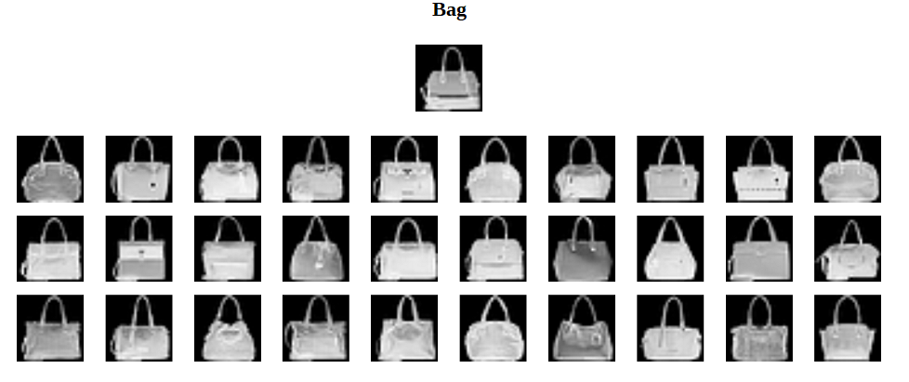
Example Queries
Example 9 (closest K=30 neighbors)

Slide 24
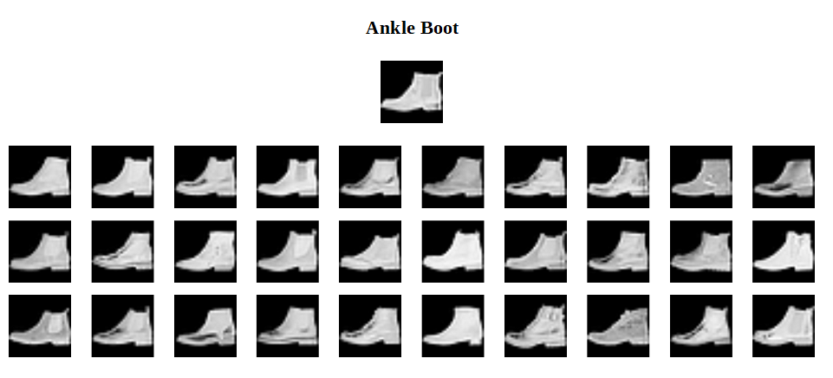
Example Queries
Example 10 (closest K=30 neighbors)

Slide 25
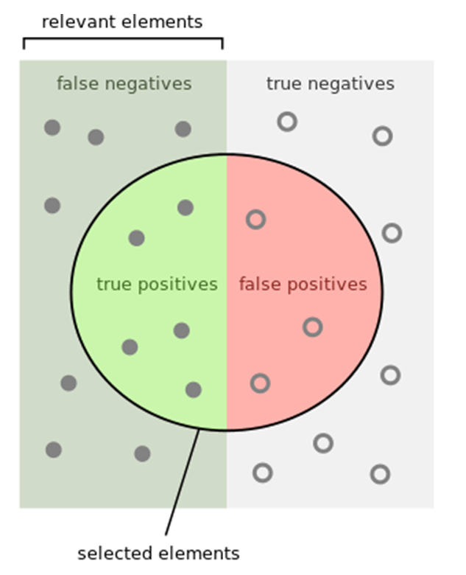

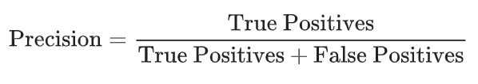
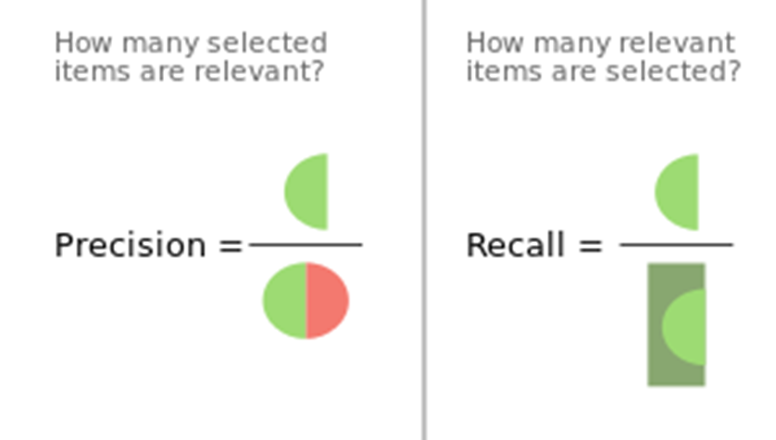
Metrics
Precision & Recall

Slide 26
Results
Precision & Recall
We have calculated average precision and recall metrics for various experiments:
Using 100 different random test images as search queries
Using different values of K ranging from 1 to 500
Using features vectors extracted from different neural network layers
Using various similarity metrics (Cosine, Euclidean, etc)
When K increases the precision decreases and recall increases
The extracted feature vectors from the 'dense_1' layer lead to better metric results
Cosine similarity produces leads to better metric results
There is a trade-off between precision and recall

Slide 27
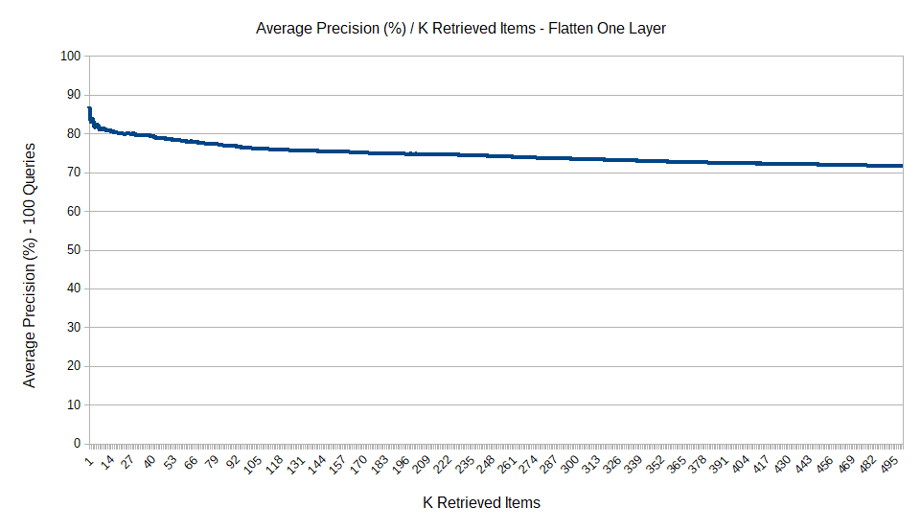
Curves
Average Precision / K Retrieved Items (for flatten_1 layer)

Slide 28
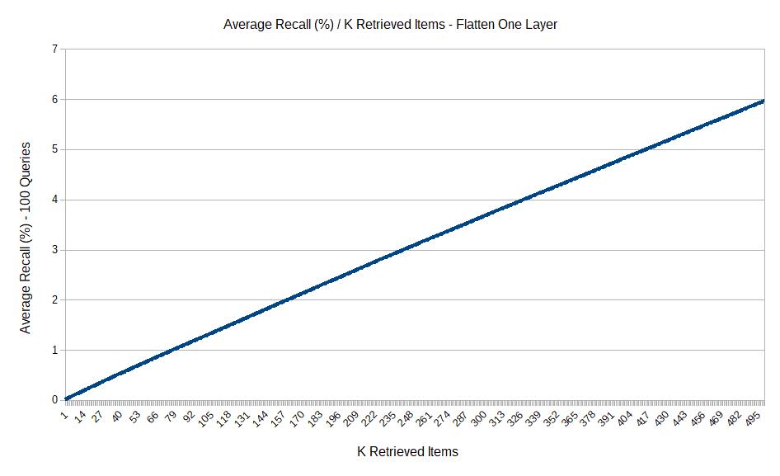
Curves
Average Recall / K Retrieved Items (for flatten_1 layer)

Slide 29
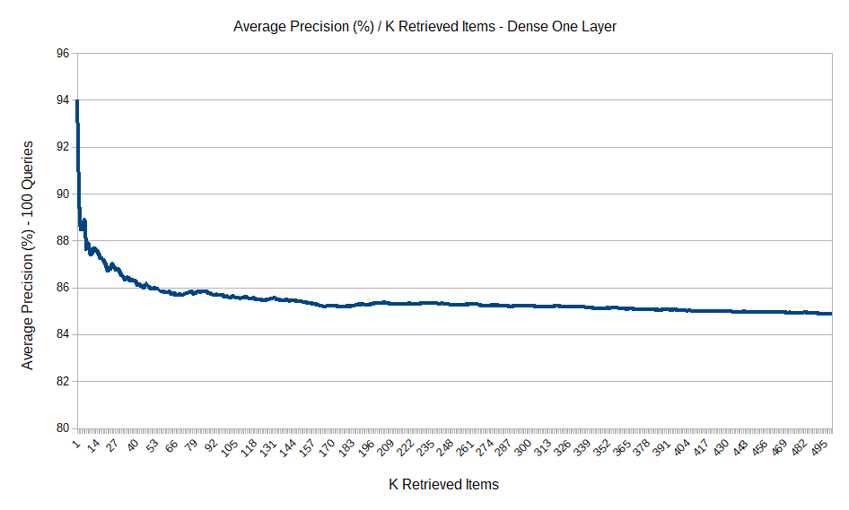
Curves
Average Precision / K Retrieved Items (for dense_1 layer)

Slide 30
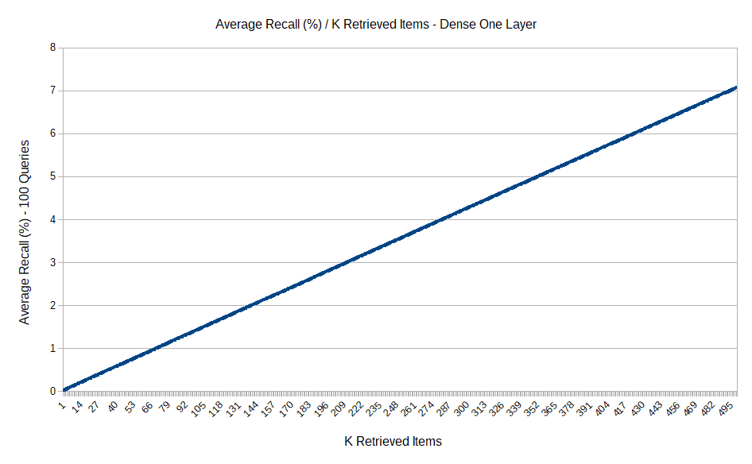
Curves
Average Recall / K Retrieved Items (for dense_1 layer)

Slide 31
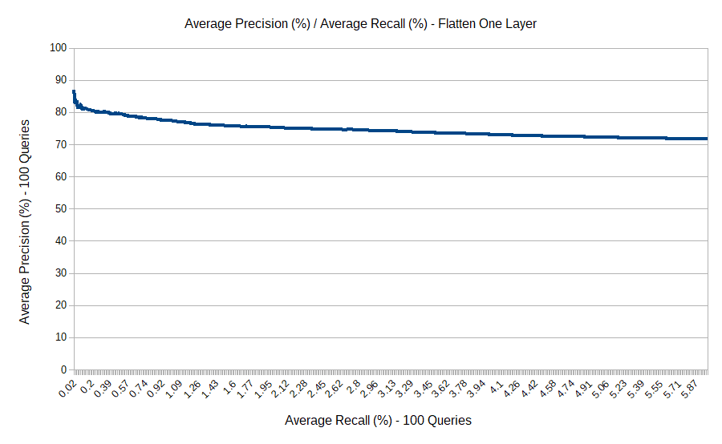
Curves
Average Precision / Average Recall (for flatten_1 layer)

Slide 32
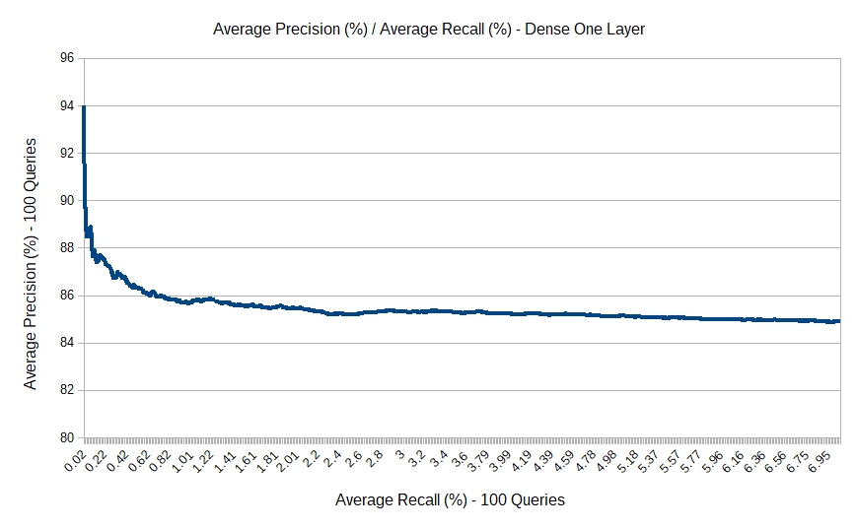
Curves
Average Precision / Average Recall (for dense_1 layer)

Slide 33
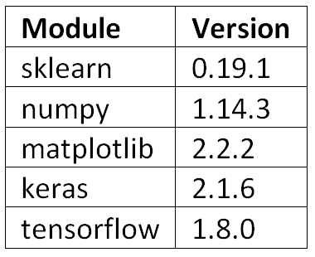
Software Requirements
Programming Languages : Python
IDE : Spyder
Application-level Dependency Manager: Anaconda
Python Modules :

Slide 34
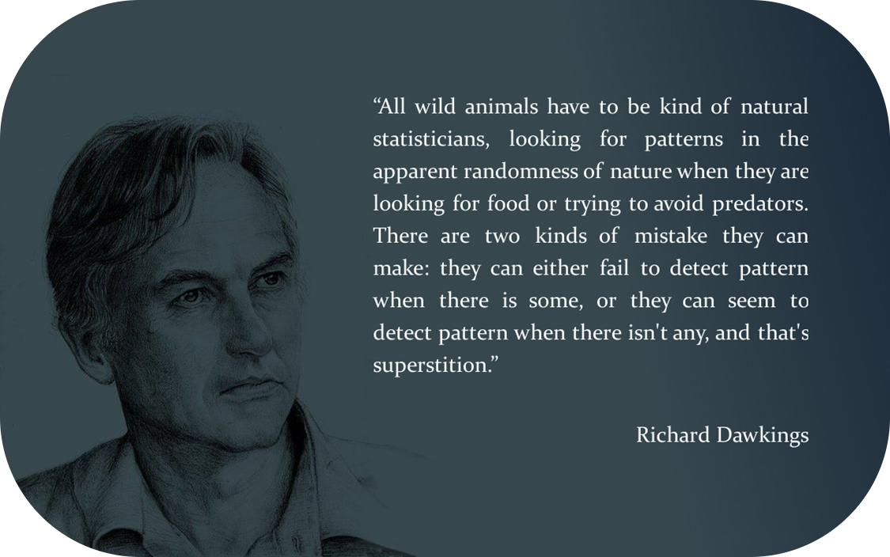
Thank you a lot and have a nice day!

